Slide 1
AI Today – Trends
Introduction to Machine Learning Computer Science BSc Course, ELTE Faculty of Informatics
László Gulyás
Associate Professor Department of Artificial Intelligence lgulyas@inf.elte.hu

Slide 2
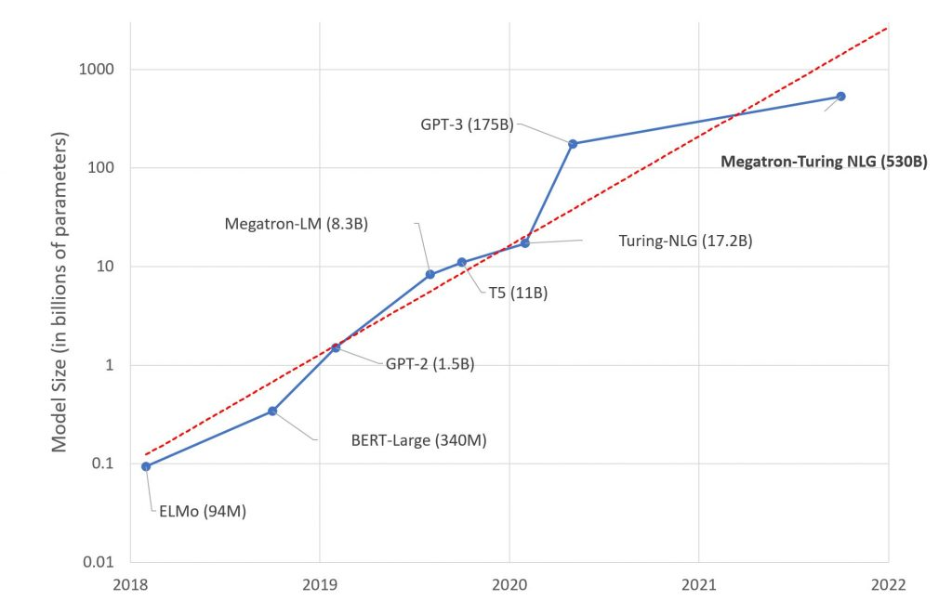
Trends – Not Discussed Today
https://www.microsoft.com/en-us/research/blog/using-deepspeed-and-megatron-to-train-megatron-turing-nlg-530b-the-worlds-largest-and-most-powerful-generative-language-model/

Slide 3
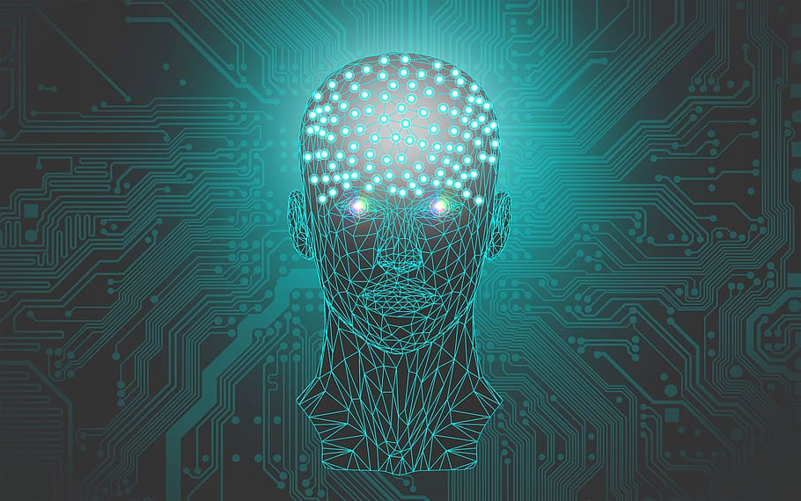
Trends Discussed – Specialisation
Role

Slide 4
Trends Discussed – Specialisation
Domain
Role

Slide 5
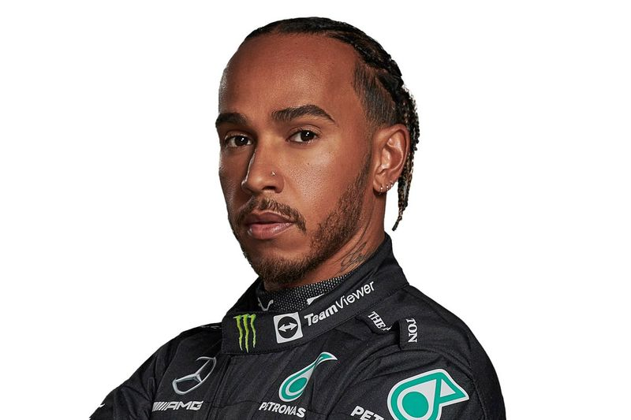
Analogy

Slide 6
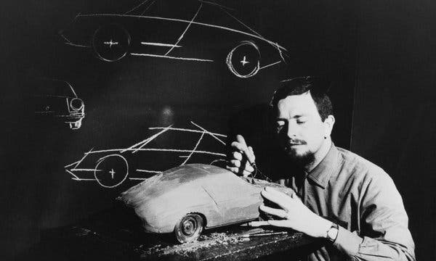
Analogy
Ferdinand Porsche Car Designer Genius
Lewis Hamilton 7-times F1 Champion

Slide 7

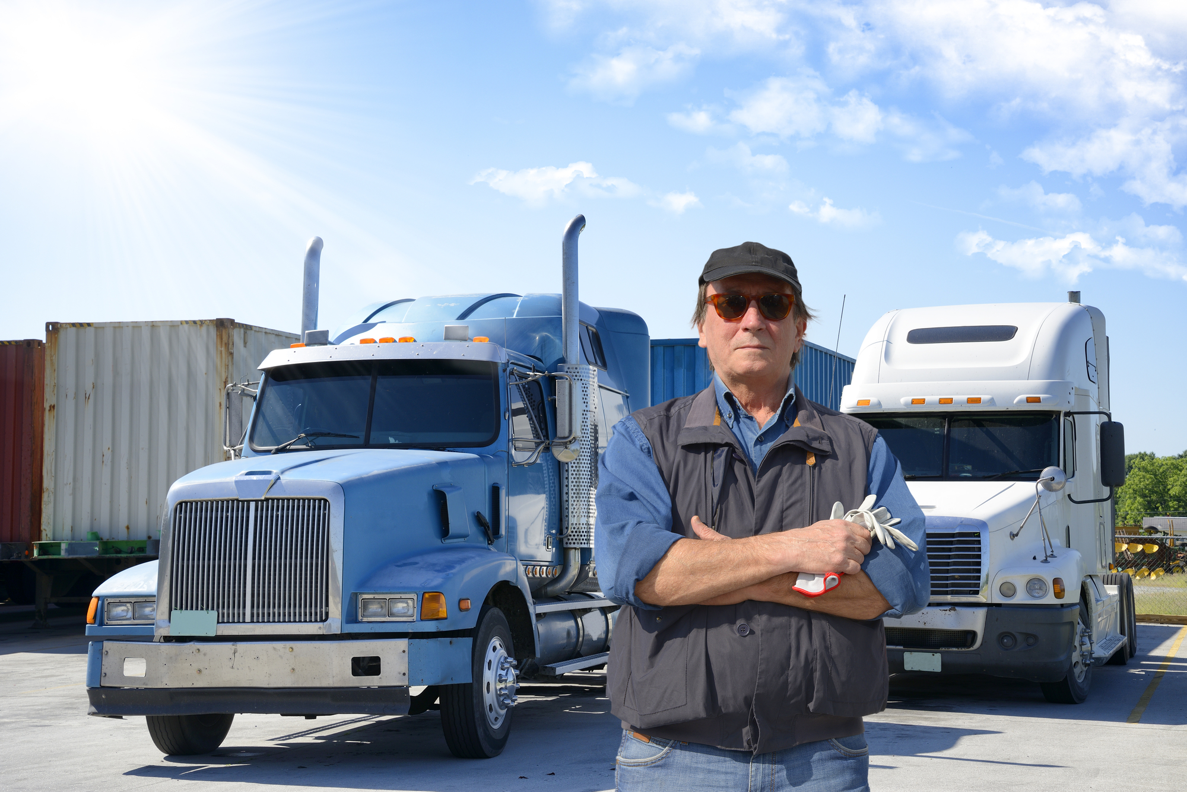

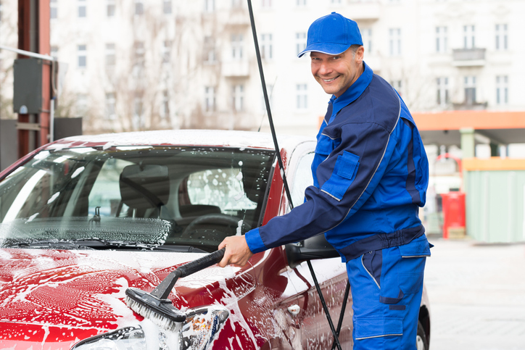

Role Specialisation

Slide 8
„Computer Expert”

Slide 9
„Computer Expert”
Software Development
Architekt
Tester
Operations
Coder
DevOps
System Admin
Service Technician
UX/UI

Slide 10
„Computer Expert”
Software Development
Software Developer
Front-end
Back-end
Full-stack
Hardware Developer
Embedded Systems Programmer
Hardware Engineer
Coder
Architekt
Tester
UX/UI
Operations
DevOps
System Admin
Service Technician

Slide 11
Role Specialisation
Data Science
Data Analyst
Data Scientist
Data Engineer

Slide 12
Role Specialisation
Data Science
Data Analyst
Data Scientist
Data Engineer
AI Engineer
AI Scientist
Artificial Intelligence

Slide 13
Role Specialisation
Data Science
Data Analyst
Data Scientist
Data Engineer
AI Engineer
AI Scientist
Artificial Intelligence
AI Analyst?
Prompt Engineer?

Slide 14
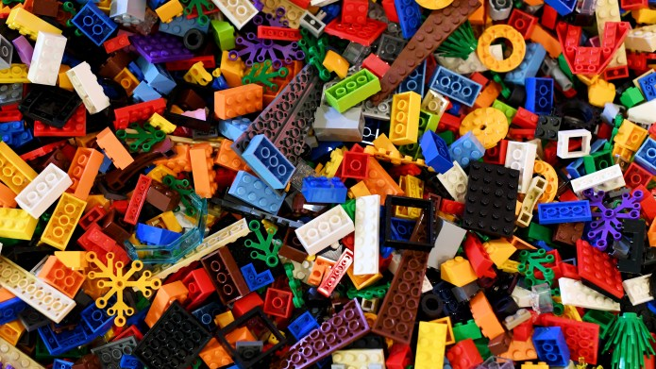
Background
De facto standard model architectures
C.f. Classic Algorithms
C.f. Design Patterns
Transfer Learning
Downloadable pre-trained models (ResNet-18, YOLOv8, etc.)
Starting from scratch is rare
Rapidly growing ‚library’
Best practices to be applied

Slide 15
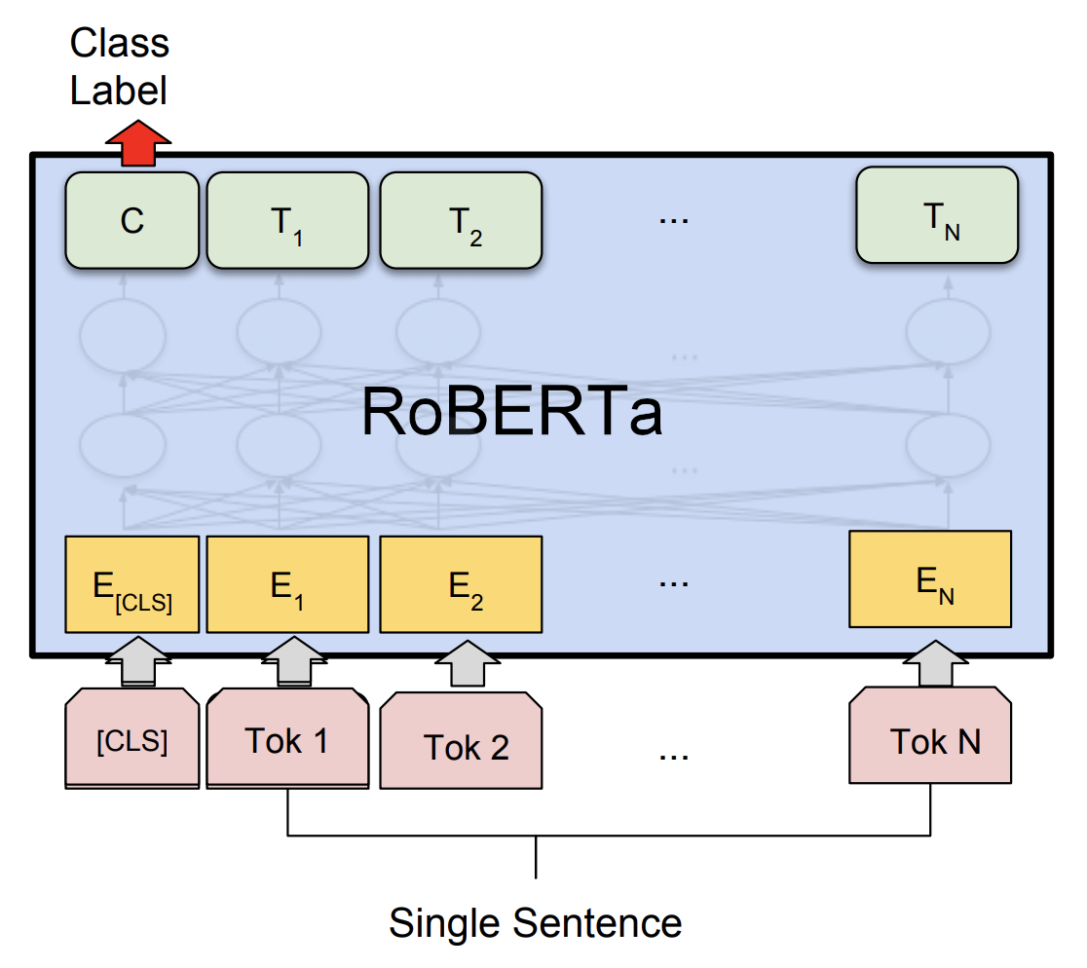
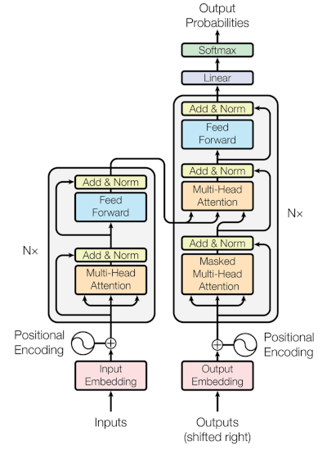
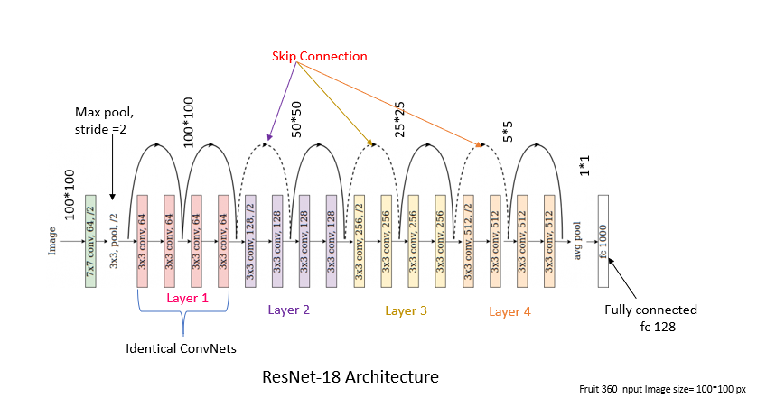
Background

Slide 16
Specialisation
Role

Slide 17
Specialisation
Domain
Role

Slide 18
Domain
Data (general)
MLP
RBM
Image, Video:
advanced
RNN
GRU
Natural Language Processing
Graphs
LSTM
Image, Video:
classification
CNN: AlexNet, VGG16, GoogLeNet
DenseNet, MobileNet, Resnet-18, ZfNet, FractalNet
WideResNet, PyramidalNet, Residual Attention Net, EfficientNet
Time Series
Transformers, Attention mechanism
Large Language Models
ChatGPT-x, LLAMA, PaLM2, PULI
GNN, GCN, GAT
Autoencoders
BERT, RoBERTa, HUBERT, DistilBERT, XLNet
Attention mechanism
AGCN, GGP, DCN, DGCN
GGNN, Graph LSTM
FastGCN, GraphSAGE
Object detektion
R-CNN, Fast R-CNN, Faster R-CNN, YOLOvX
Instance Segmentation
3D modelling
Pose Estimation
OpenPose, MediaPipe, MeTRAbs
Mask R-CNN, Keypoint R-CNN, SAM, SEEM
NERF
PointNet

Slide 19
Specialisation
Domain
Role

Slide 20
Implications
Specialisation
Specialised education
Diversified expectations at workplace
Testing
Proof of Correctness
New Requirements
Explainable Models
AI Engineer
AI Designer

Slide 21
Thank you!
László Gulyás
Associate Professor Department of Artificial Intelligence lgulyas@inf.elte.hu

Slide 22
BACKUP

Slide 23
